Slide 1

Valley Photonic Crystals for 6G Communication
Bachelor's Thesis I – Autumn '24
Devansh Satra - Department of Physics, IIT Bombay
Supervisors
Prof. Anshuman Kumar, LOQM, IIT Bombay
Prof. Abhishek Kumar, UTSP, JNCASR

Slide 2
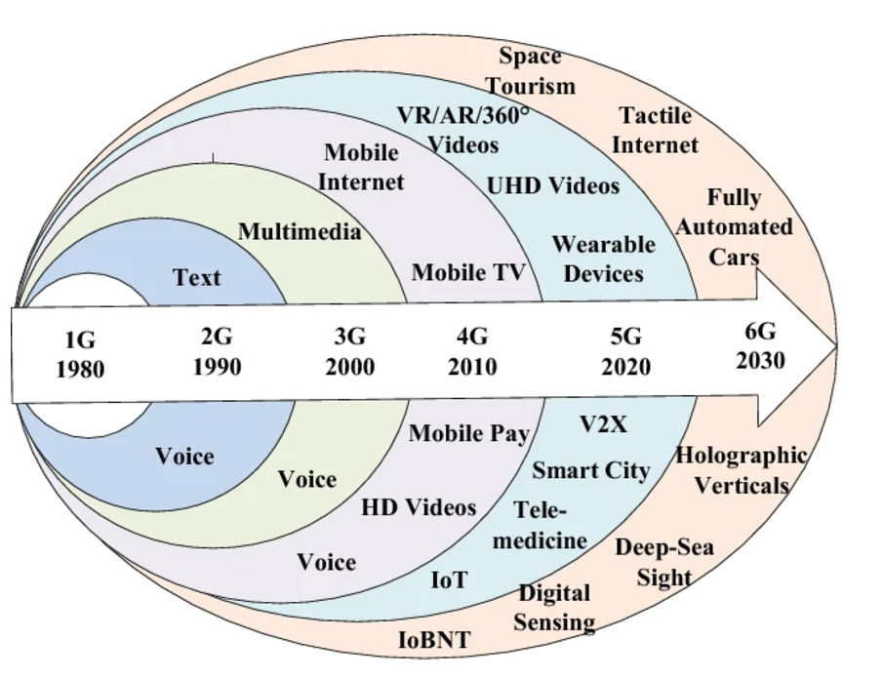
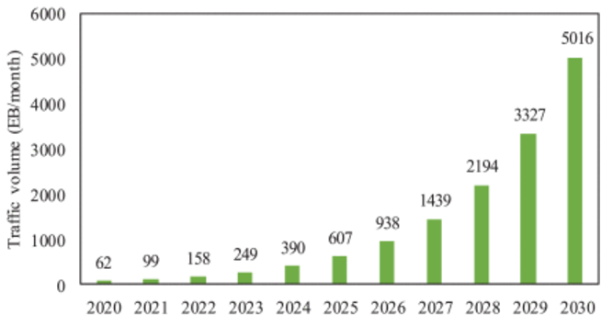
Motivation for 6G Communication
Need for Faster Communication:
Growing demand for ultra-fast data rates due to IoT, AR/VR, and connected smart cities.
Limitations of 5G: limited bandwidth, inability to meet future data traffic demands.
Akhtar, M.W., et al. Hum. Cent. Comput. Inf. Sci. 10, 53 (2020).
M. Z. Chowdhury, et al. IEEE Open Journal of the Communications Society, vol. 1, pp. 957-975, 2020

Slide 3
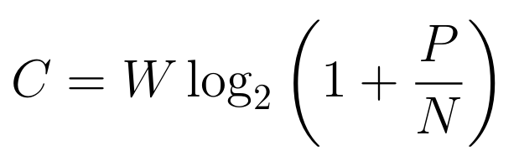
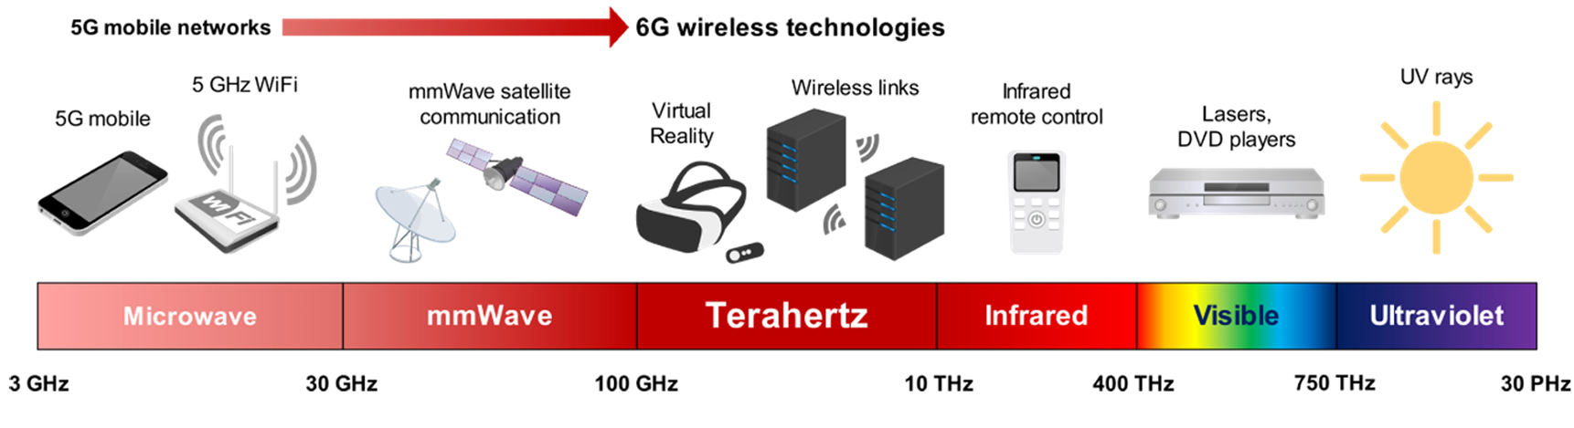
Why Terahertz for 6G Communication?
THz frequencies (0.1–10 THz) provide an increase in available bandwidth compared to compared to 5G.
Potential to support massive data traffic and extremely low latency.
Suitable for extremely high data rates and short-range communication.
Yi Ji Tan. 2023. URL: https://hdl.handle.net/10356/165280.

Slide 4
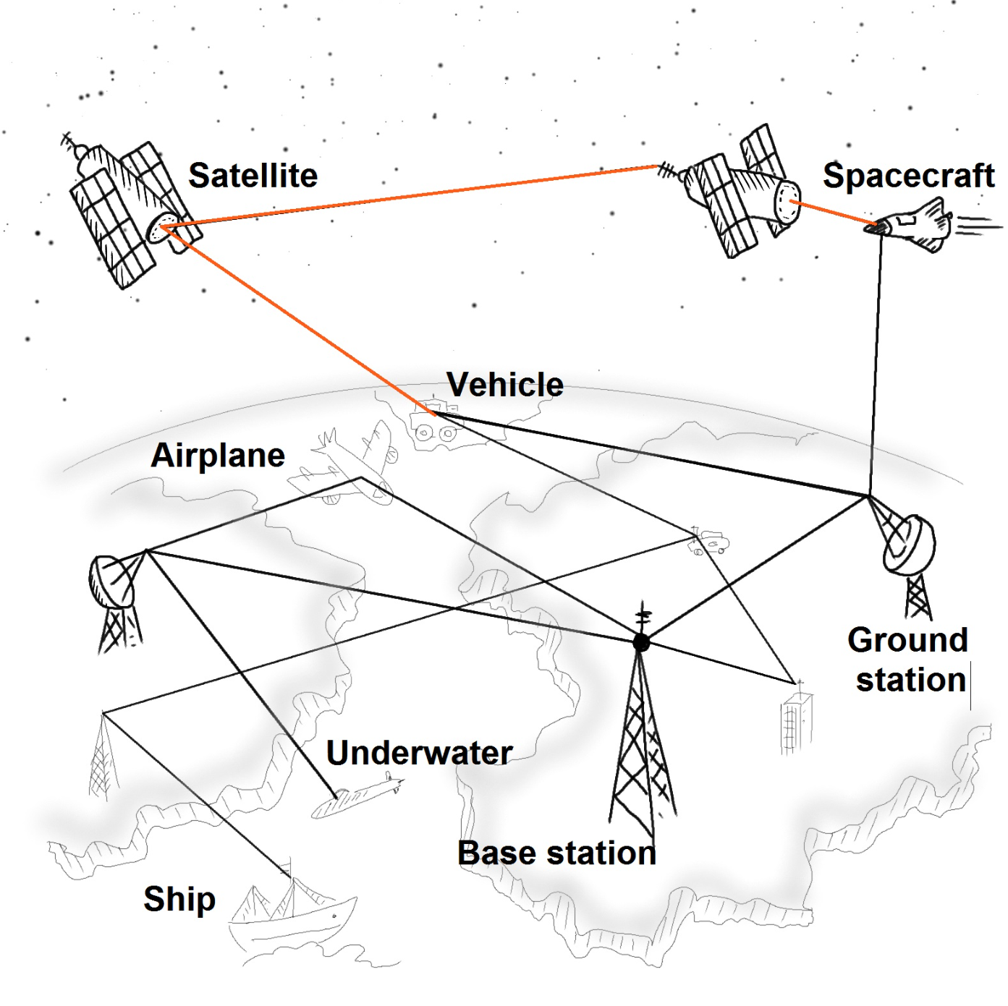
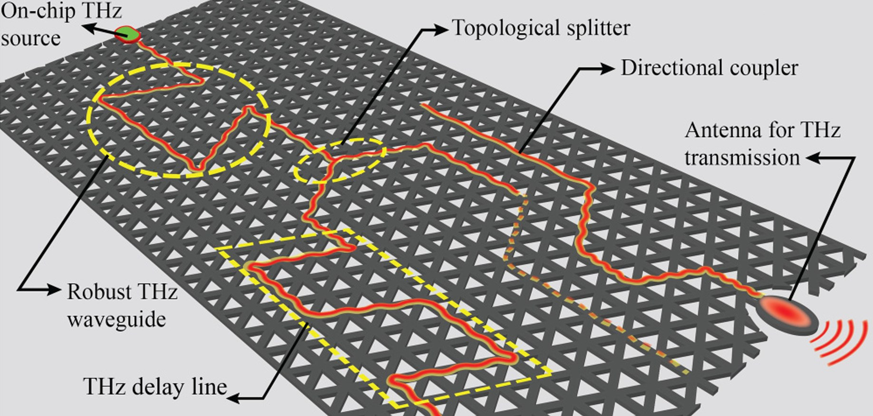
Terahertz Communication
On-Chip Communication
Free Space Communication
Integrated Photonic Circuitry - Valley Photonic Crystals
Compatible with free space Terahertz technologies
On going technological development – in tune with Photonic Technologies
Abhishek Kumar, et al. J. Appl. Phys. 14 October 2022; 132 (14): 140901.
Garlinska M, et al. Future Internet. 2020; 12(11):179

Slide 5
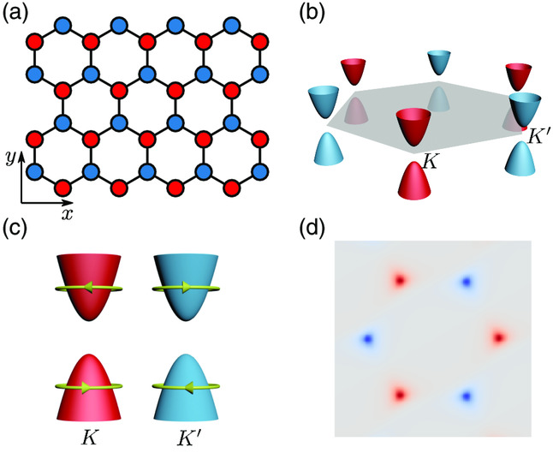
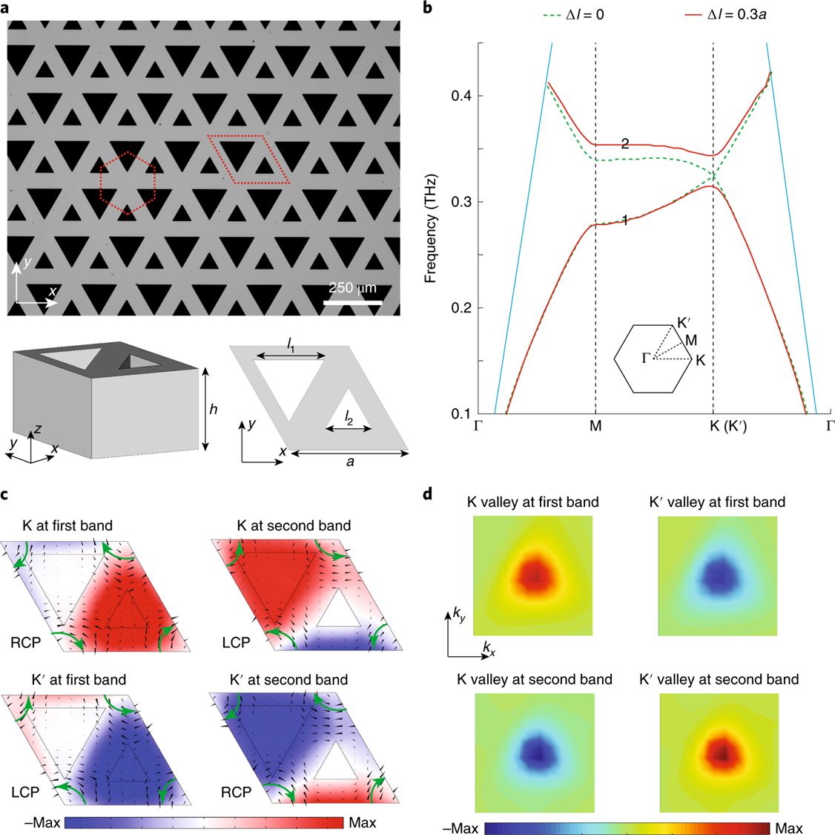
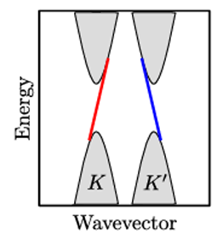
Valleytronics
Valley Photonic Crystal
Haoran Xue, et al. Advanced Photonics Research, 2(8): 2100013, 2021.
Y. Yang, et al. Nat. Photon. 2020, 14, 446.

Slide 6
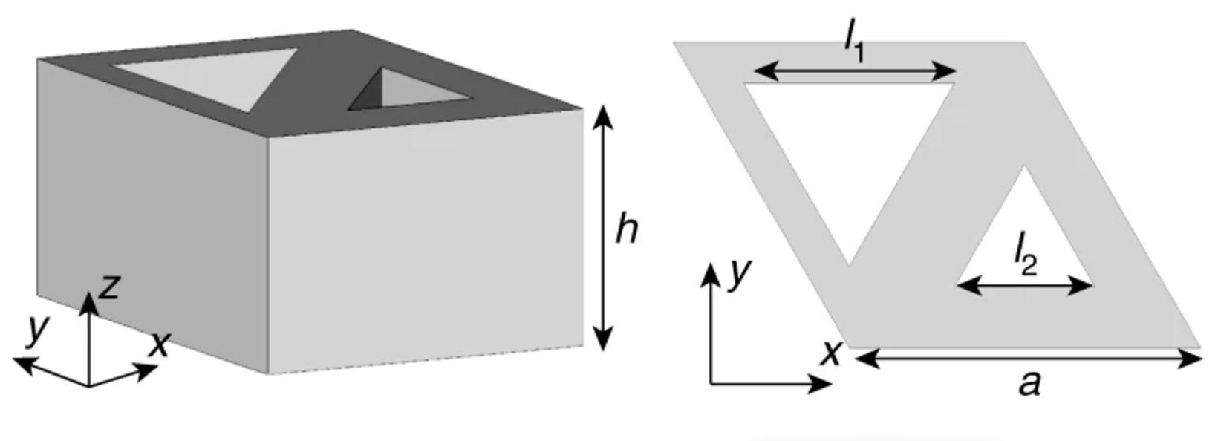
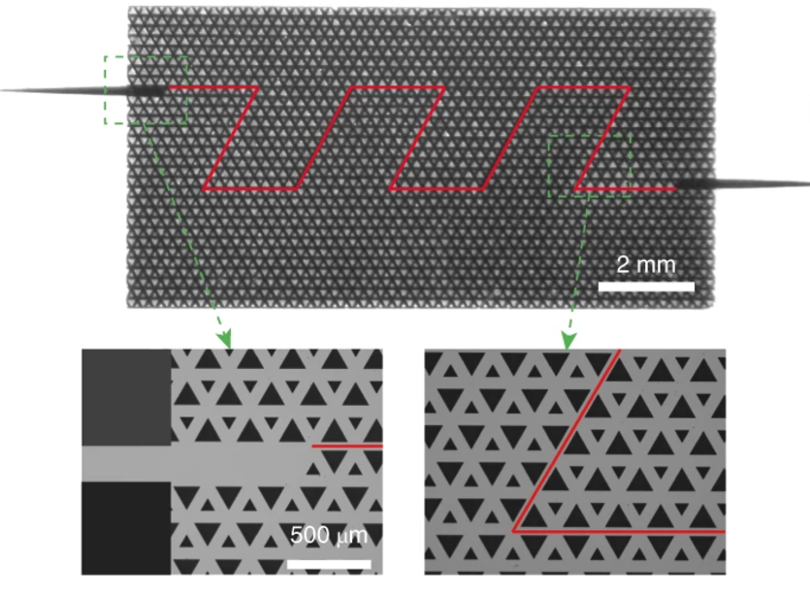
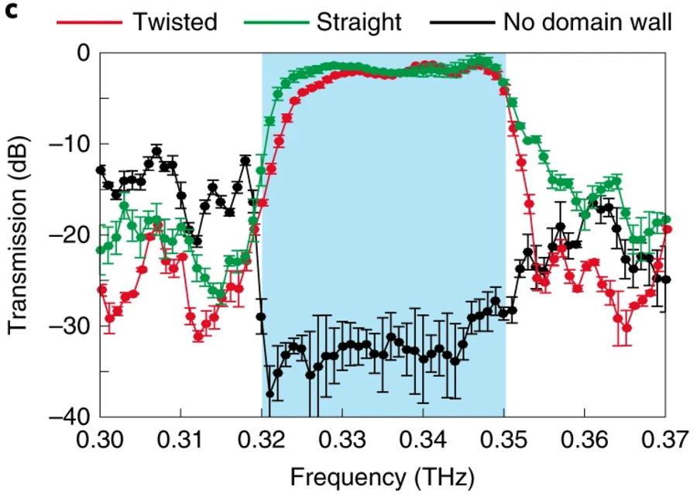
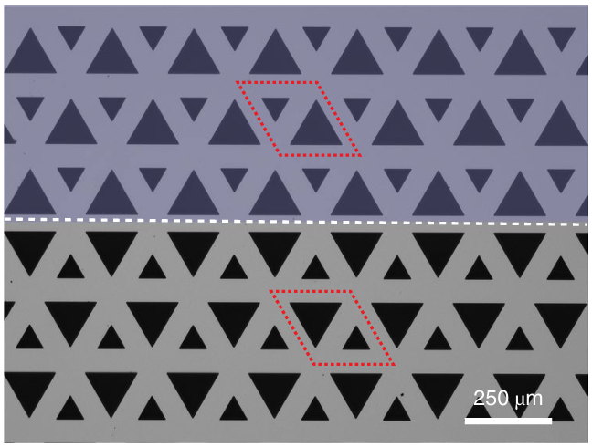
Applications of VPCs
Robust THz Waveguiding: Minimal losses compared to conventional waveguides along the twisted domain walls.
Low Bending Losses: Immune to sharp bends due to topologically protected valley kink states.
High Data Transfer Rates with very low bit error rate, much superior to conventional THz waveguides.
Experimental observation of robust topological valley kink states along a twisted domain wall in a Thz photonic chip. Y. Yang, et al. Nat. Photon. 2020, 14, 446.

Slide 7
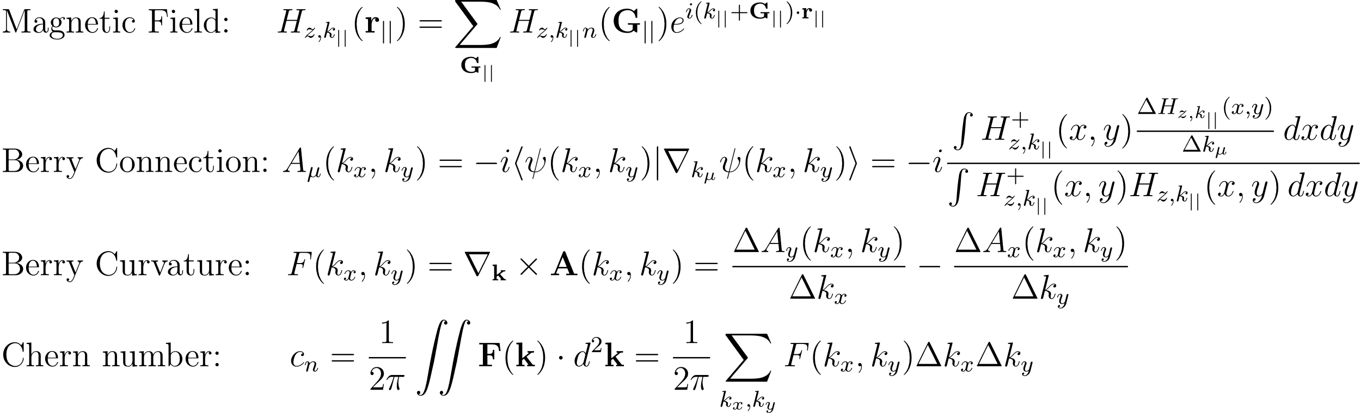
Plane Wave Expansion (PWE) Method
Utilizes periodicity to expand dielectric function and electromagnetic fields as Fourier series using reciprocal lattice vectors.
TE Mode

Slide 8
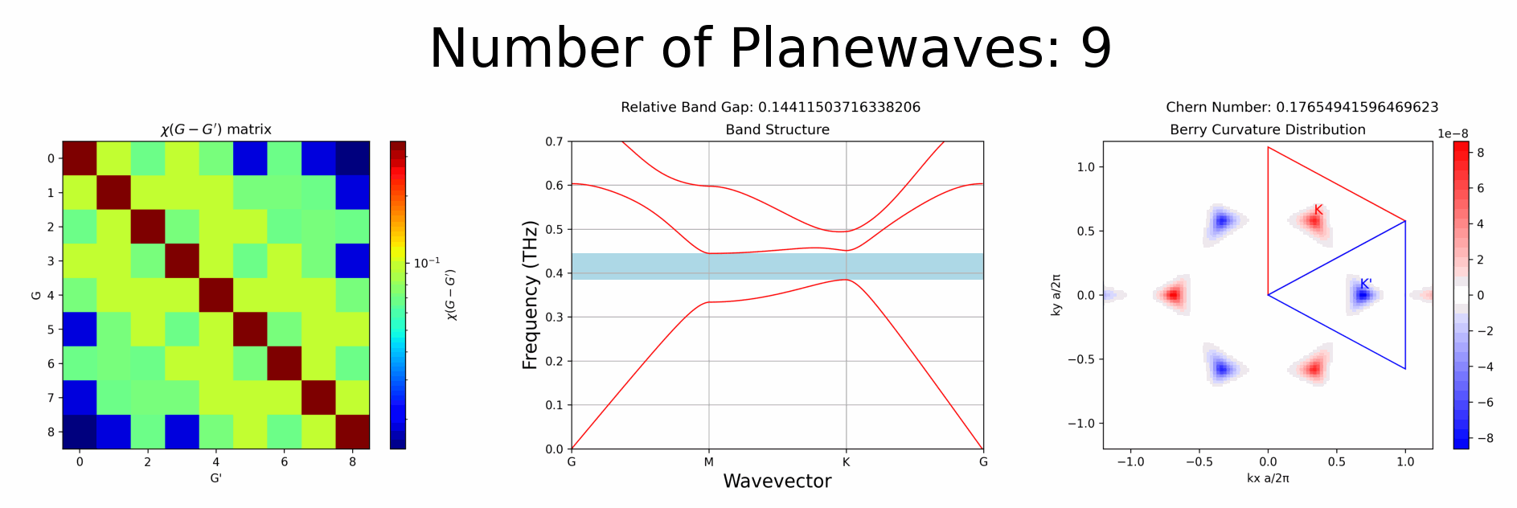
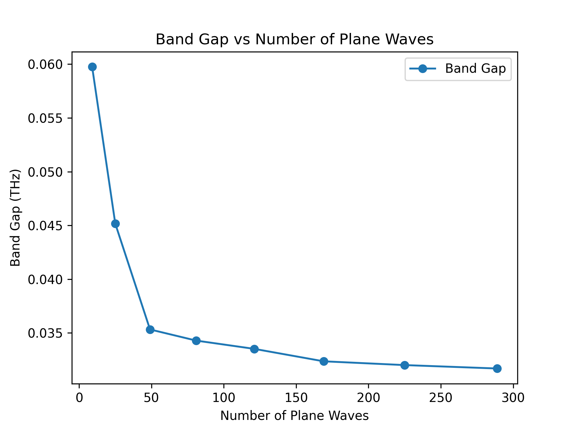
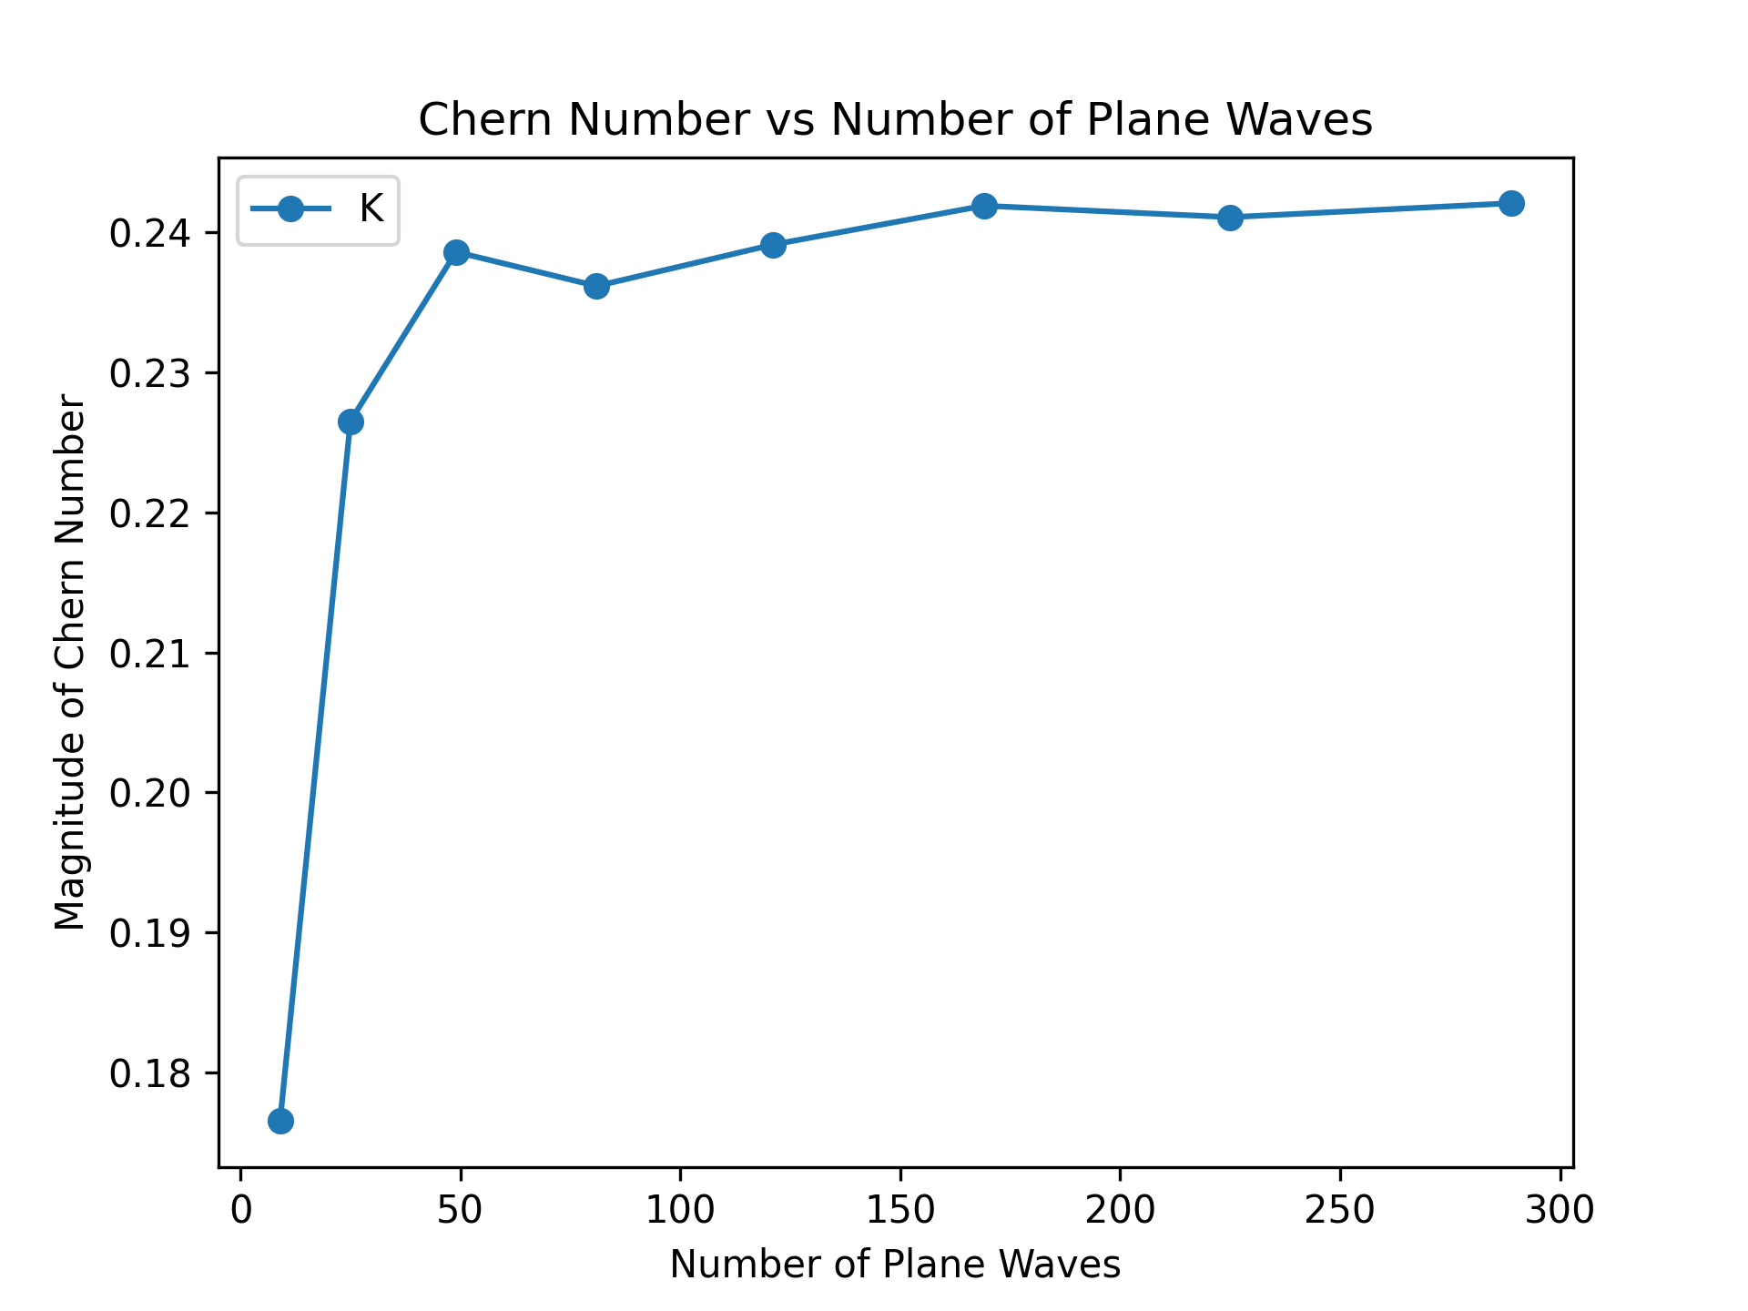
Convergence Testing with Number of Plane Waves

Slide 9
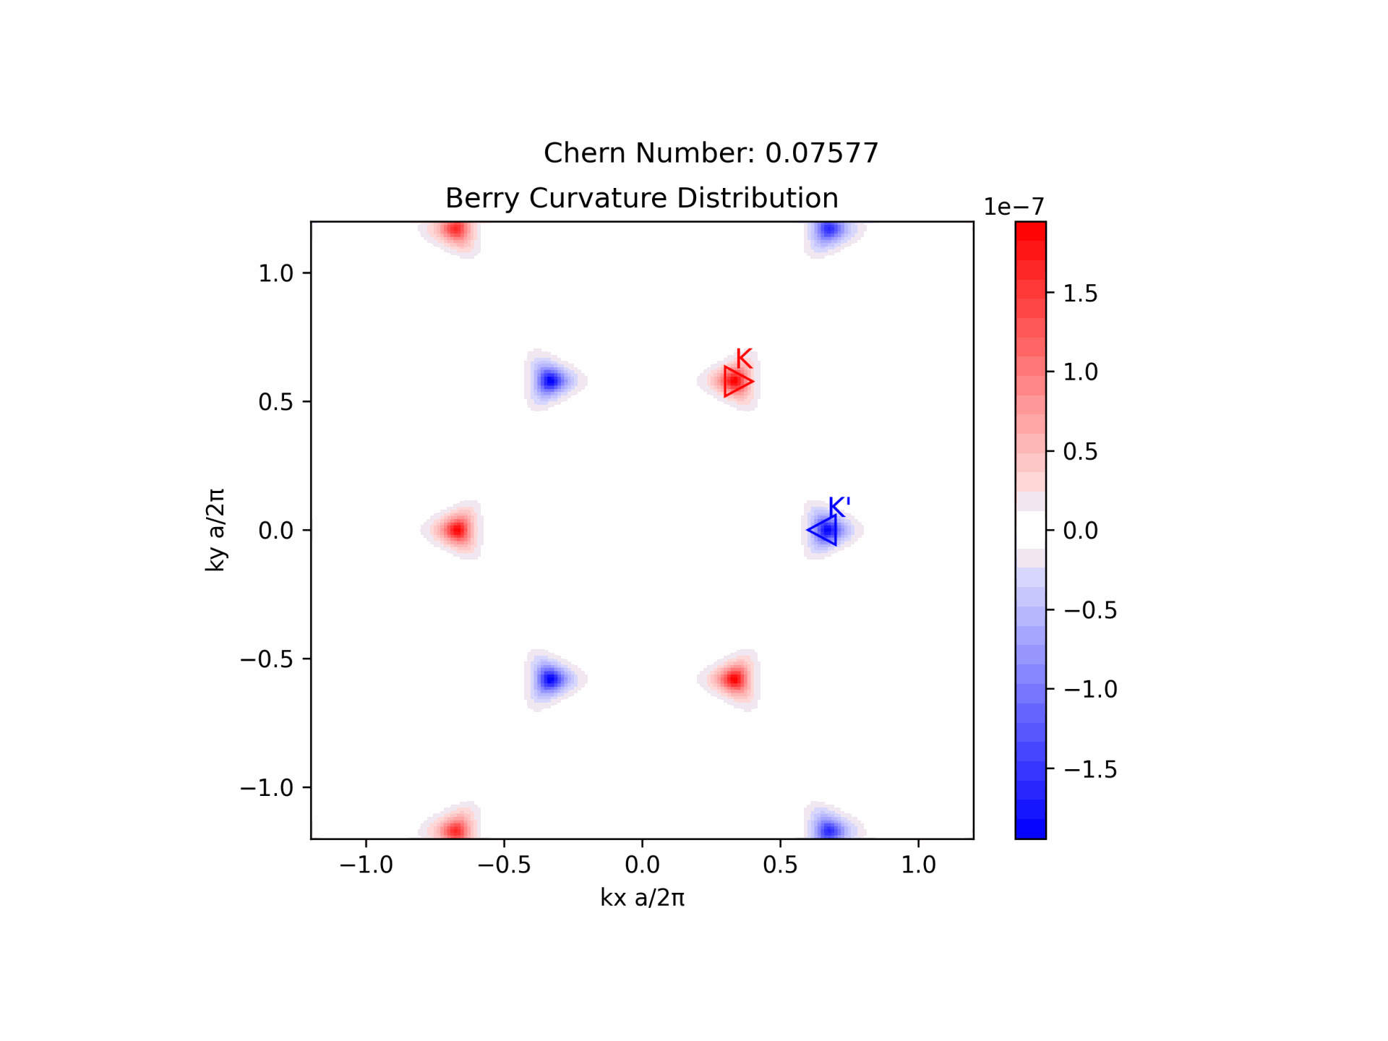
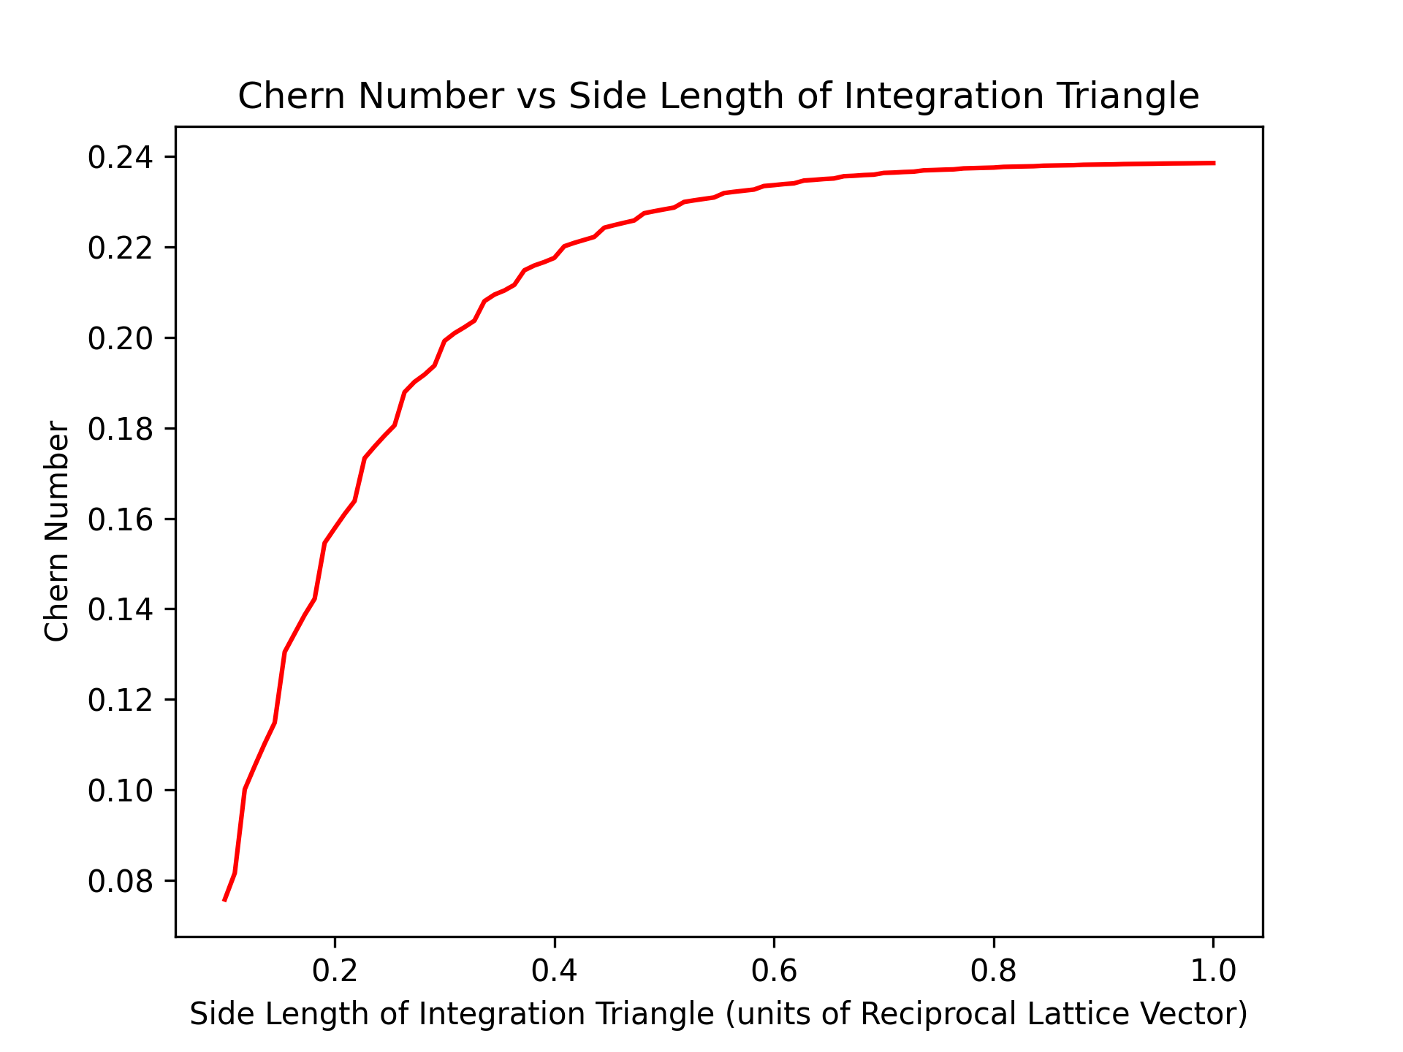
Convergence of Valley Chern Number with Area of Integration

Slide 10
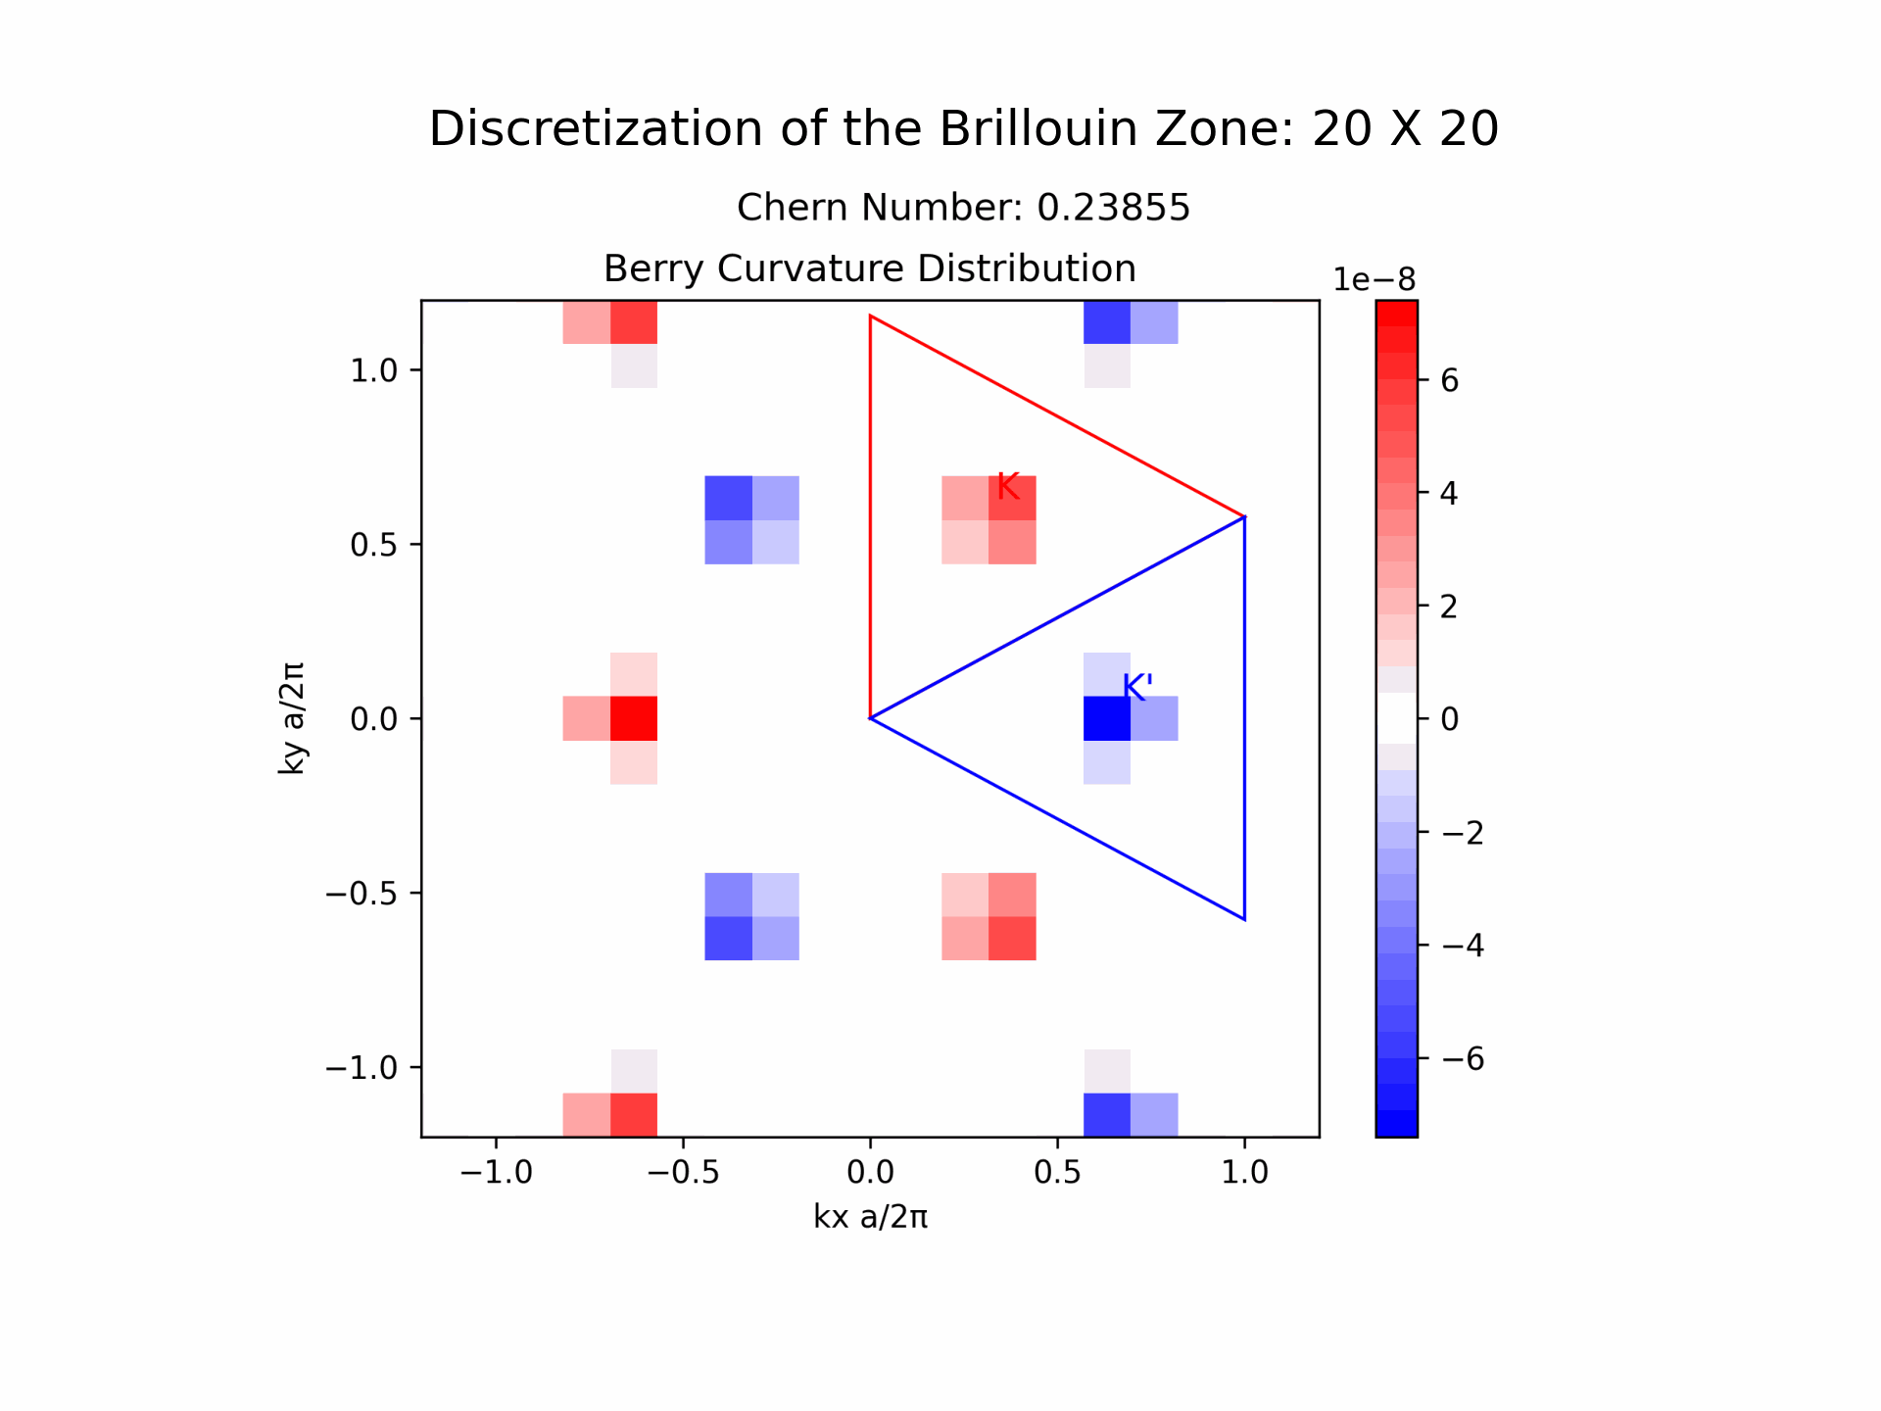
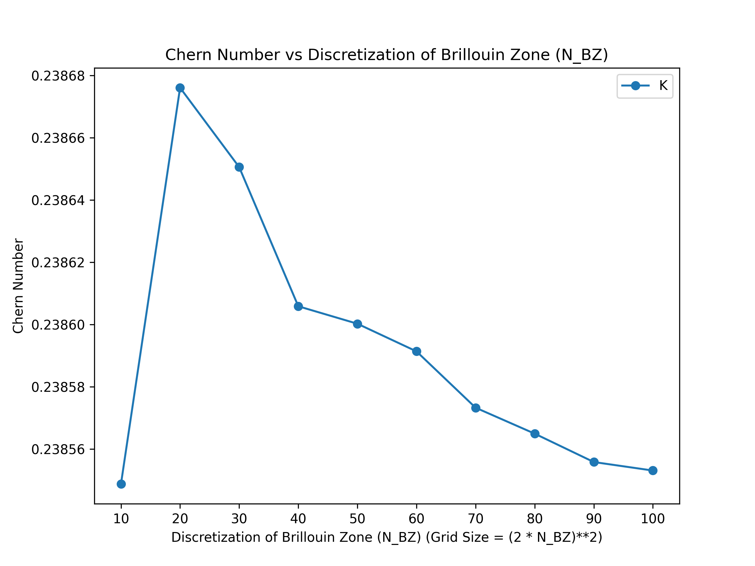
Convergence of Valley Chern Number with Discretization of Brillouin Zone

Slide 11
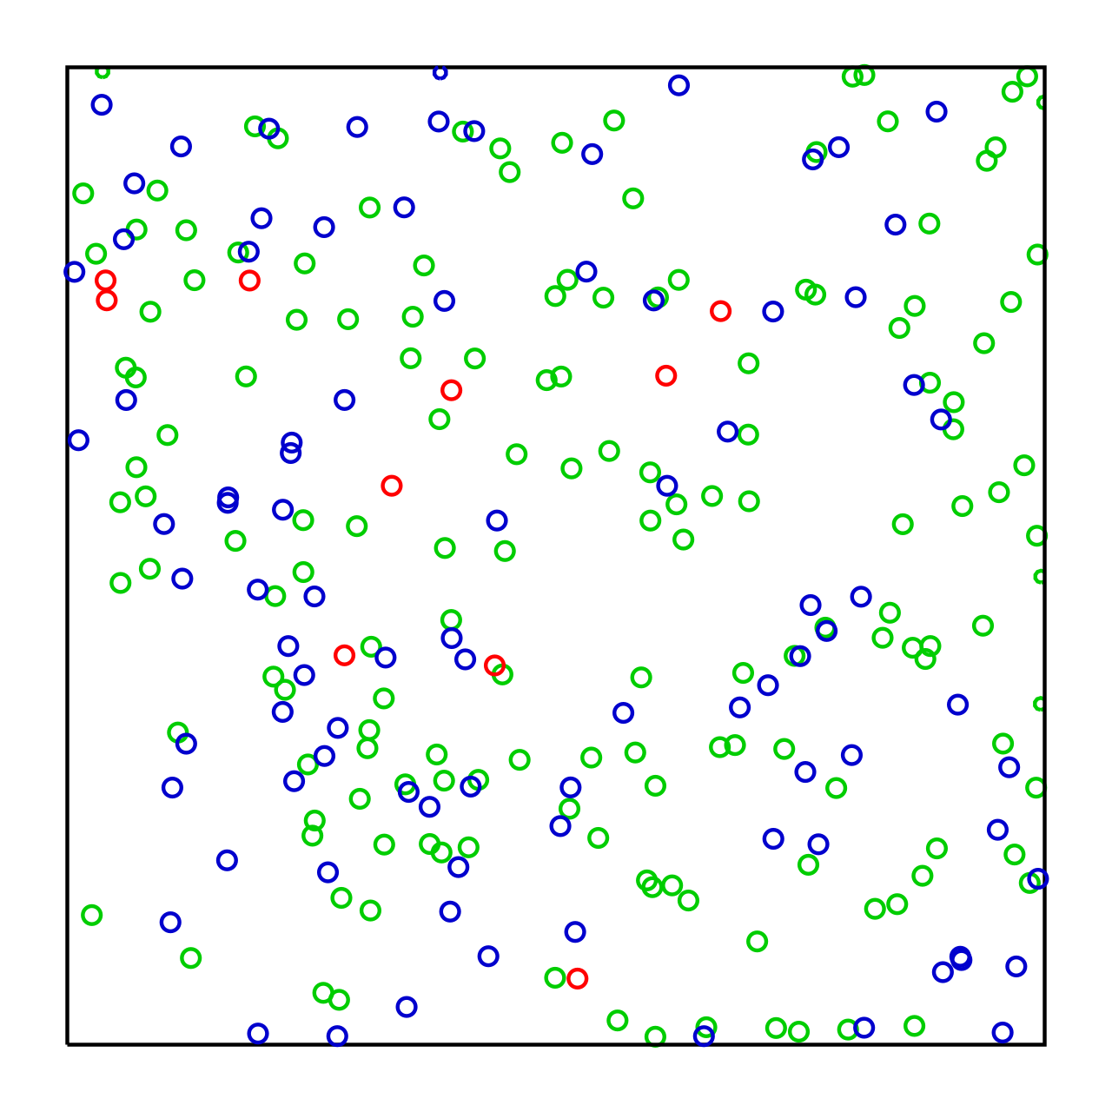
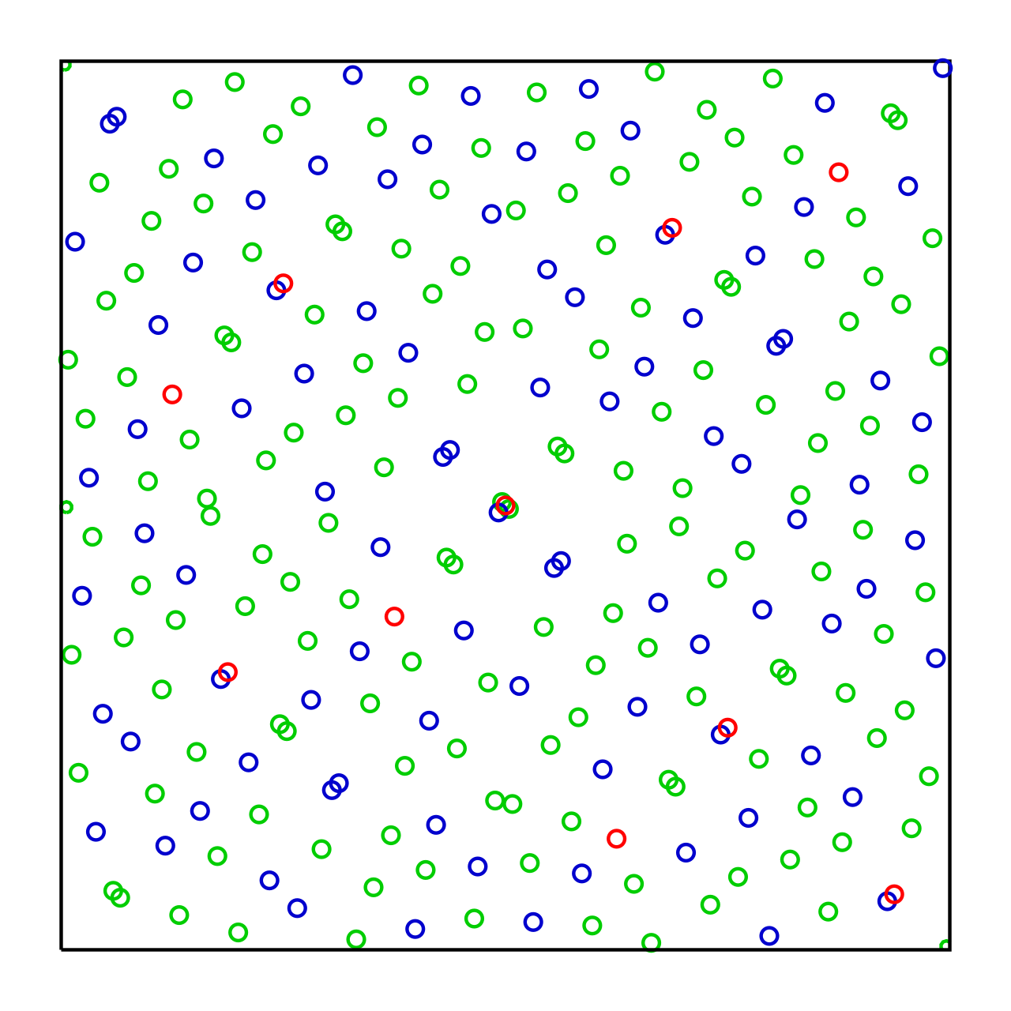
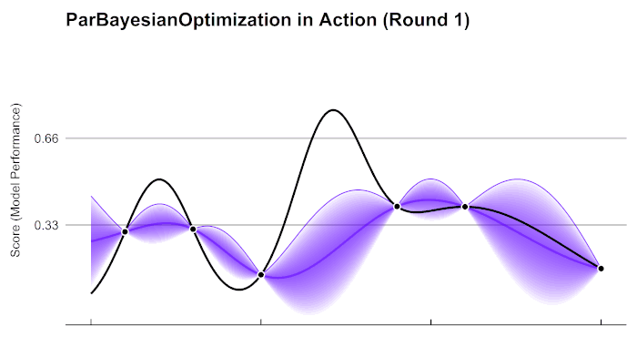
Optimization Methodology
Bayesian Optimization (BO) is a probabilistic model-based optimization method.
Efficient for optimizing high-dimensional, computationally expensive functions.
https://en.wikipedia.org/wiki/Sobol_sequence
Initialization: Initial 20 points are sampled via a Sobol sequence
Model Update: The Gaussian Process (GP) model is now trained
Acquisition Function: Next sample point is chosen using an acquisition function (EI).
Iterative Process: Evaluate the new point, update the model, and repeat.
https://en.wikipedia.org/wiki/Bayesian_optimization

Slide 12
Figure of Merit for Optimization
Relative Band Gap
Topological Criterion
Valley Chern Number

Slide 13
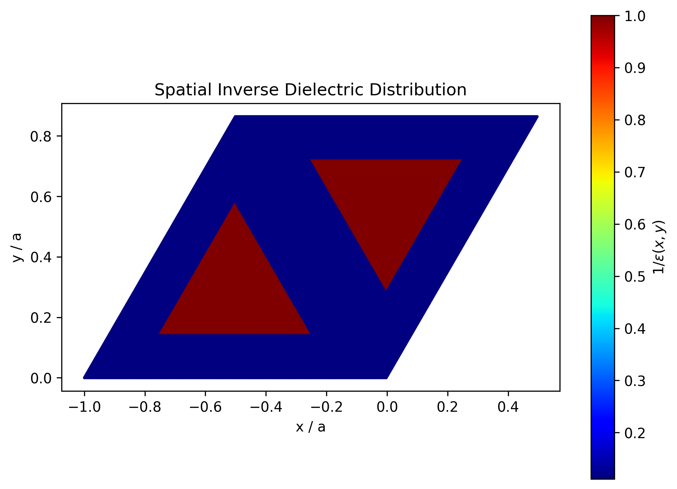
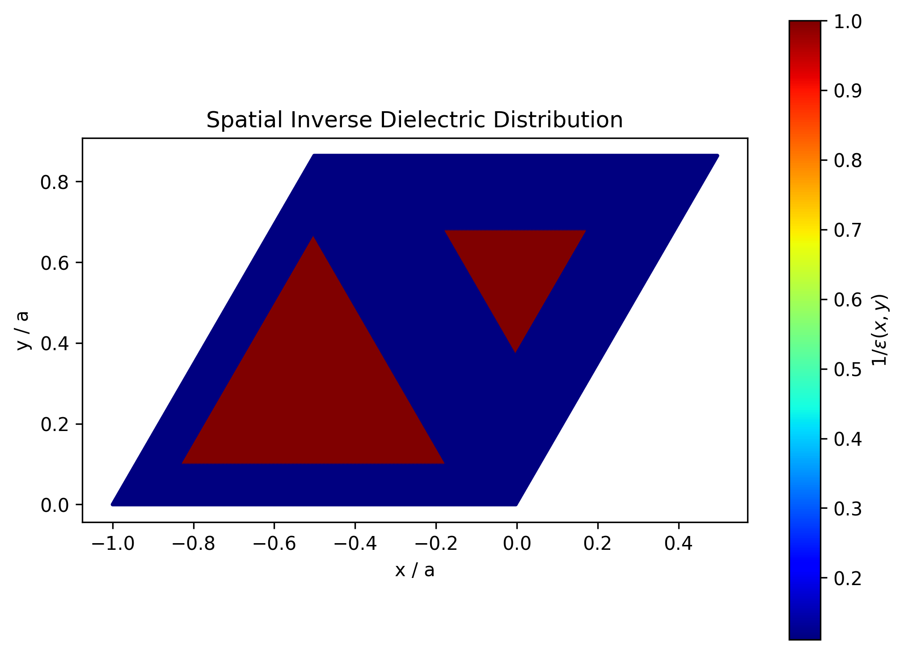
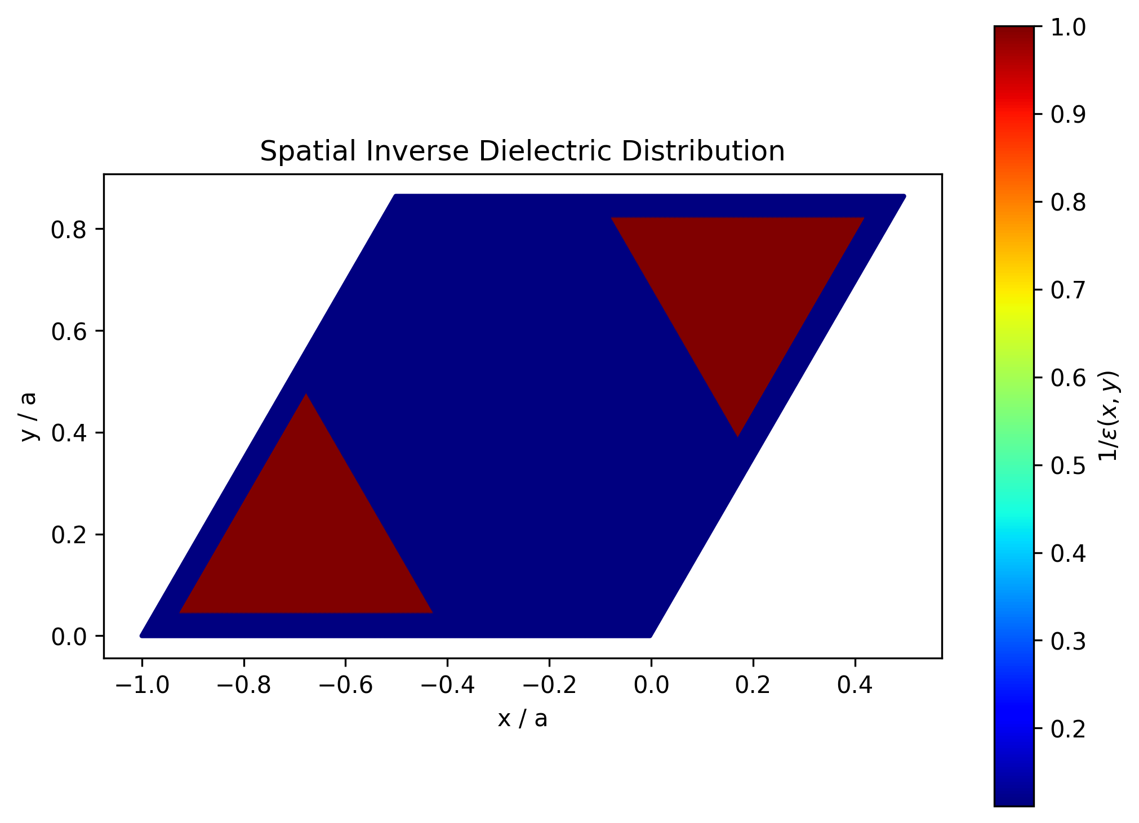

Optimization Parameters
L central
δ L (Asymmetry Parameter)
Symmetry Separation
Rotation Angle

Slide 14
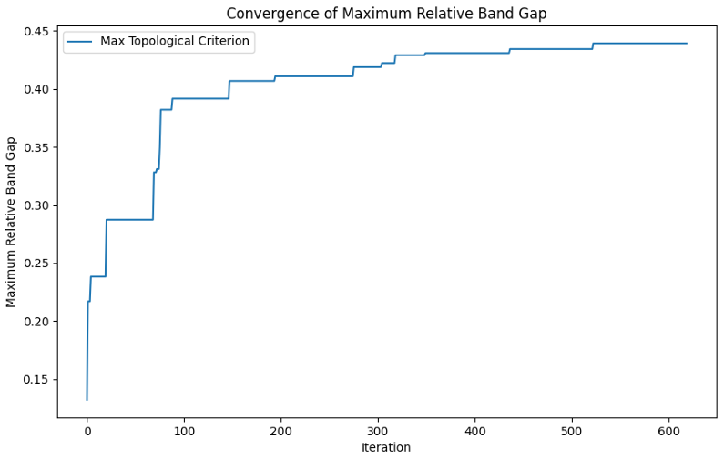
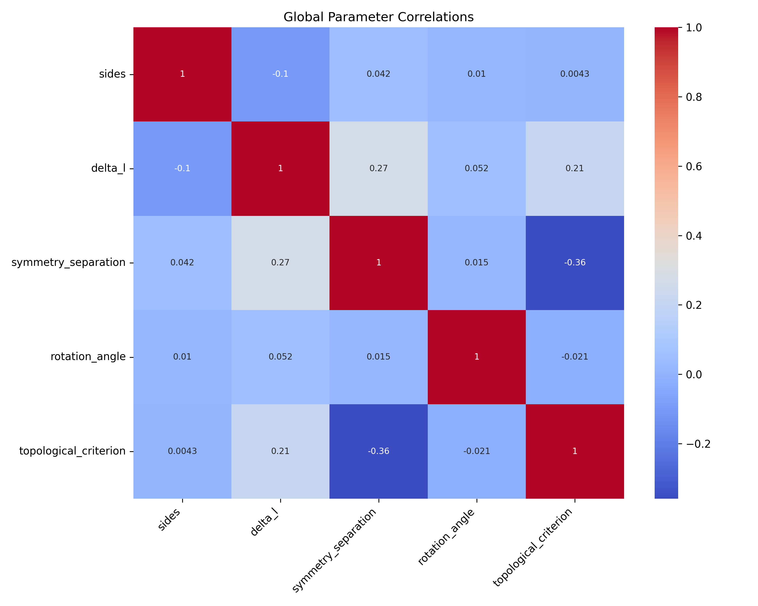
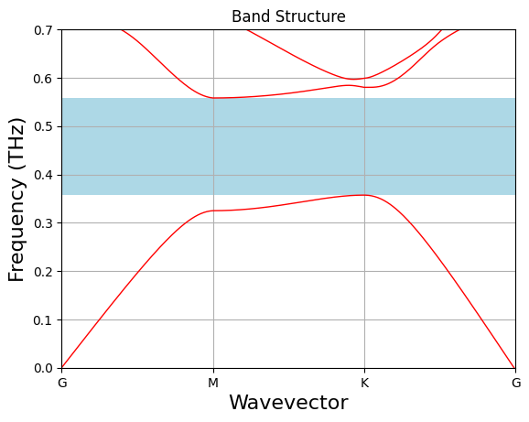
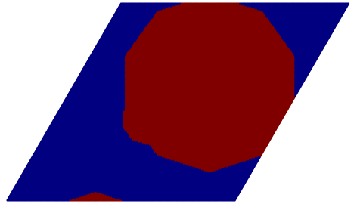
Optimization Results for Relative Band Gap

Slide 15
Future Work
Advanced Optimization Techniques
Particle Swarm Optimization (PSO)
Neural Network-Based Optimization
Study on Fabrication Imperfections
Experimental Validation

